Slide 1
UVM Primer Notes
Based on “UVM Primer”
2013, Ray Salemi
Supplemented with:
verificationguide.com

Slide 2
ALU and test bench
completely test “tinyALU” functionality
simulate all lines of RTL and paths
coverage first method
self-checking test bench

Slide 3
coverage model
•Test all operations
•Simulate all zeros on an input for all operations
•Simulate all ones on an input for all operations
•Execute all operations after a reset
•Run a multiply after a single cycle operation
•Run a single cycle operation after a multiply
•Simulate all operations twice in a row
sequence matters as much as individual ops.
Want 100% coverage – stay tuned

Slide 4
anatomy of a test bench
stimulus
  tester.sv
self-checking
  scoreboard.sv
coverage
  coverage.sv
connect DUT
  (interface or bus functional model)
  tinyalu_bfm.sv

Slide 5
ALU operations
typedef enum bit[2:0] {no_op, ...,
rst_op = 7} operation_t;
// rst_op is for test bench convenience; not defined for device itself

Slide 6
Coverage Block
covergroup: give each a name, then define its bins
SV new function instantiates oc and c_00_FF
Much more on this later in the quarter

Slide 7
tester block
also known as generator block
random, constrained to legal values
two independent functions
  get_op()
  get_data()
choose number of operations
manage signal protocol
adapt to different programs

Slide 8
scoreboard loop
need to know right answers
  typically from math, algorithm, or product specifications
  potential for garbage in / garbage out
then simply compare results

Slide 9
Why UVM?
Functional Coverage Goals –
  measured automatically
Constrained random stimulus
Self-checking
Modularity
  reusability
  robustness
  standardization
  portability

Slide 10
SystemVerilog interface
BFM for TinyALU
  clock
  reset_alu task
  send_op task
  not just a bus!
See tinyalu_bfm.sv

Slide 11
task benefits
encapsulation:
  1) do not have to sprinkle code w/ protocol-level behavior;
  2) can modify all protocol level behavior in one place and propagate
BFM handles timing details for inputs, controls, clocking, etc.

Slide 12
the whole test bench
see top.sv
  BFM
    note tidy encapsulation of DUT ports & their timing
  tester
  scoreboard
  coverage

Slide 13
Scoreboard.sv
// We turned a loop into a module
module scoreboard(tinyalu_bfm bfm);
always @(posedge bfm.done) begin #1ns;
case (bfm.op_set)
  add_op: predicted_result = bfm.A + bfm.B;
  and_op: predicted_result = bfm.A & bfm.B;
  ...
endcase // case (op_set)
if ((bfm.op_set != no_op) && (bfm.op_set != rst_op))
  if (predicted_result != bfm.result)
$error ("FAIL: A: %0h B: %0h op: %s result: %0h",
bfm.A, bfm.B, bfm.op_set.name(), bfm.result);

Slide 14
tester.sv (greatly simplified)
module tester(tinyalu_bfm bfm);
function operation_t get_op();
op_choice = $random;
case (op_choice)
3'b000 : return no_op;
3'b001 : return add_op;
...
endcase // case (op_choice)
endfunction : get_op
function byte get_data();
zero_ones = $random;
if (zero_ones == 2'b00) return 8'h00;
else if (zero_ones == 2'b11) return 8'hFF;
else return $random;
endfunction : get_data

Slide 15
tester.sv, continued
initial begin
bfm.reset_alu();
repeat (1000) begin : random_loop op_set = get_op();
  iA = get_data();
  iB = get_data();
  bfm.send_op(iA, iB, op_set, result);

Slide 16
OOP
first attempt: C++ linked to Verilog using Program Language Interface
  very complicated
  hard to use
  Accellera standards group:
    SystemVerilog = Verilog + Vera + Superlog
    Superlog = Verilog extensions

Slide 17
Why OOP?
•Code Reuse
•Code Maintainability
•Memory Management

Slide 18
Code Maintainability
avoid copying from one section to another
  then editing one, forgetting to edit the other
  package did that, as well
write common code in one place
  access it anywhere in testbench
changes made in object by someone else
  can automatically update in your code
  if called by reference

Slide 19
Code Reuse
Programming objects contain:
  data
  tasks and functions that operate on that data.
Given a defined object
  don't need to know what's inside;
  use it as the documentation tells you to.
Reuse ➔ testbench becomes more powerful with every new function.
  add new functionality to previous work.

Slide 20
Memory Management
test bench processes allocate memory
share it between threads
happens transparently to the user

Slide 21
SystemVerilog structs
group of homo/heterogeneous data
can reference entire group at once
packed struct: treat as single vector
unpack is default, but not synthesizable
example: struct_example.sv
example: simple FIFO
see also next two slides

Slide 22
Structs
typedef struct {
int length;
int width;
} rectangle_struct;
typedef struct {
int side;
} square_struct;
/* data structure, not a class
completely independent rectangle & square
structs here, but stay tuned ... */

Slide 23
rectangle struct
module top_struct;
rectangle_struct rect_s;
initial begin
// method not inside struct
rect_s.l = 50;
rect_s.w = 20;
$display(“area =%d”,rect_s.l*rect_s.w);
end

Slide 24
square struct
module top_struct;
square_struct sq_s;
initial begin
sq_s.side = 25;
$display(“area = %d”,sq_s.side**2);
/* simulator allocates memory when struct is declared; keep watching regarding classes */

Slide 25
now add some class ☺
  class rectangle; // an object
  int length;
  int width;
  function new(int l, int w); // method
  length = l;
  width = w;
  endfunction
  function int area(); // method
  return length*width;
  endfunction
  endclass

Slide 26
class rectangle
two data members
  length
  width
one method
  area
Simulator memory not allocated until new called ... ➔

Slide 27
memory allocation
module top_class;
rectangle rect_h;
initial begin
rect_h = new(.l(30),.w(20));
$display(“area = %d”,rect_h.area());
// note we have called the method area
end
endmodule

Slide 28
malloc, continued
rect_h = handle to a rectangle
enough memory for just the handle
allocate memory for object with new()
  . notation acts like regular Verilog
  pass values into data members
new() instantiates the object

Slide 29
malloc, ctd.
new memory for objects w/ new()
reclaims memory when we stop referencing an object
create second rectangle under rect_h ➔
  memory recovered from first rectangle object

Slide 30
Classes and Extension
Classification
  e.g. animal taxonomy
  e.g. well-organized directories, subdirectories
  quickly find something

Slide 31
extension
squaring the rectangle
class square extends rectangle;
function new(int side);
super.new(.l(side),.w(side));
endfunction
endclass

Slide 32
Demo
top.sv
clases.sv
rectangle_only.sv
structs.sv

Slide 33
Polymorphism
polygon
  trapezoid
    parallelogram
      rectangle
        square
Polymorphism lets one store a square object in the polygon variable

Slide 34
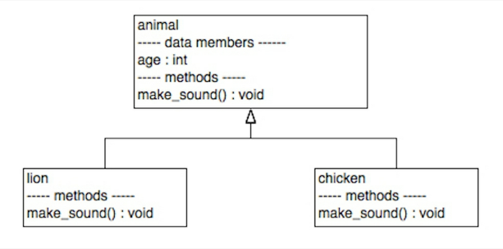
Polymorphism
classes are derived from each other

Slide 35
here, two dervied classes under one base class
// nonvirtual class example
class animal;
int age = -1;
function new(int a);
age = a;
endfunction : new
function void make_sound();
$fatal(1, “Generic animals: no sound”);
endfunction
endclass : animal

Slide 36
fatal error in demo
animal_h is calling make_sound() for animal class
lion is associated, so why $fatal instead of “roar”?
Why can’t we put a lion object in the variable type animal and still have it roar?
  Need Virtual Method

Slide 37
Virtual Methods
virtual method –
  ignore features of variable type itself
  take on features of instantiation
  see example virtual.sv
virtual function being defined is a placeholder
make_sound() defs. in lion & chicken inherited from base class

Slide 38
virtual.sv
Have added second lion, as well as chicken.
Note polymorphism of base class instance (animal_h).

Slide 39
Abstract Classes
Pure Virtual Functions
Disadvantage of above:
  if user does not force override, gets $fatal
  could come at end of a long simulation
Catching the error earlier:
  abstract class – use only as base class
  cannot instantiate object of abstract class type
Pure virtual method
  no body, must be overriden

Slide 40
Pure Virtual Animal
forces discipline
e.g., our model requires specific types of animals, won’t work with a generic “animal”

Slide 41
Examples
classes.sv
parallelogram.sv

Slide 42
How I created the cos(tilt) function:
Matlab:
  x=[0:31]; // discrete angle steps
  w=cos(x*pi/64); // 0 to pi/2
  t = round(w*128); // convert to integer
Also very useful for:
  direct digital synthesis
  FFTs
  modulation/demodulaton

Slide 43
Ch 7Static Methods & Variables
Problems with global variables:
  1) Hard to find type
  2) Easy for other part of program to change
Static variables
  OOP’s attempt to resolve 1 and 2

Slide 44
Declaration of static variable
memory that stores an object allocated by new()
... but ...
static variable gets allocated on declaration
exists only one copy, used everywhere
analogous to static variable

Slide 45
single global cage for all lions
class lion_cage
static lion cage[$]; // static queue
endclass : lion_cage
// queue holds lion objects
we can access cage w/o instantiating an object thereof
see also: verificationguide.com/systemverilog/

Slide 46
operators in queues
see SV examples of queue operators
Queueing up.ppt

Slide 47
Static Methods
class lion_cage;
protected static lion cage[$];
static function void cage_lion(lion l);
cage.push_back(l);
endfunction : cage_lion
static function void list_lions();
$display(“Lions in cage”);
foreach (cage[i])
$display(cage[i].get_name());
endclass : lion_cage

Slide 48
protection
protected: prevents direct access to method
give static access methods (cage_lion and list_lions) to protected variable: cage
static: global
next up: parameterized class defs.
  Let us cage tigers, chickens, etc.

Slide 49
Ch 8 Parameterized Class Defs.
Separate tiger_cage and lion_cage queues from my example: not efficient
Want generic animal cage
class animal_cage #(type T);
animal_cage #(lion), #(tiger), etc.
here the parameter sets type, rather than bit width, etc. we have seen before
each class (lion, tiger, chicken) creates its own copy of the static queue (cage)

Slide 50
Parameterized Variables
remove static from variable and methods
instantiate general animal_cage object and open lion, tiger, or chicken cages as needed for respective animals
animal_cage #(lion) lion_cage;
// the above holds animal_cage and instantiates the object that uses it
function void cage_animal(T animal_h);

Slide 51
Ch 9 Factory Pattern
combinations / programming tricks
to date: hardcoded new calls
lion_h = new(15, "Mustafa");
factory pattern: pass argument to method, receive back object of specified type

Slide 52
Factory, continued
function make-animal
allows changing of animals
this example: use string as argument

Slide 53
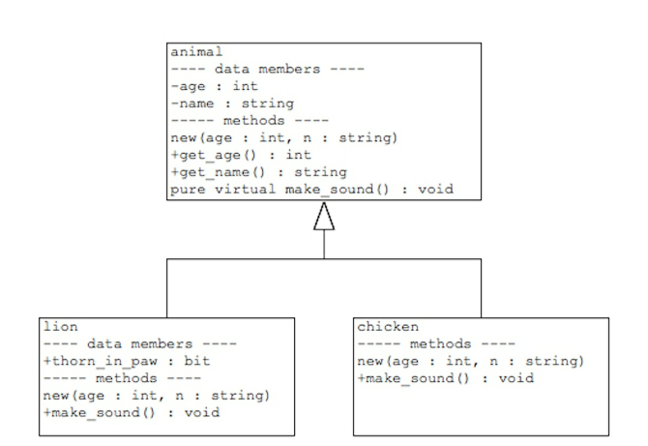
animal hierarchy

Slide 54
using factory
animal_factory has static method ==> use anywhere in test bench
make_sound is virtual method;
  tailor to species
"thorn in paw" declared in lion class, not animal class
$cast(lion_h,animal_h) -- casts animal as lion; access lion-only data members
convert second argument to class of first and copy

Slide 55
Factories in UVM
dynamically create different types of objects w/o changing source code
  strings for "lion," "chicken," etc. could be in a file instead of hard coded
factory dynamically creats testbench components
  UVM factory can override objects
on to UVM example

Slide 56
Ch 10 Object-oriented TB
https://www.edaplayground.com/x/dx7
Note: works fine in EDA playground
Doesn't seem to work in Vivado
include single_cycle, three_cycle, and tinyalu in design.sv
include tinyalu_pkg, tinyalu_bfm, top in testbench.sv
upload all .svh to testbench.sv directory
change name of testbench.svh!

Slide 57
Testbench Objects
top.sv: top-level module
  testbench.svh: top level class
    tester.svh: generates stimuli into bfm
    scoreboard.svh: DUT output vs. expected
    coverage: functional cases checklist

Slide 58
Top Level Module
import class definitions
  import tinyalu_pkg::*;
instantiates DUT and BFM
  tinyalu DUT(.A(bfm.A), ...);
  tinyalu_bfm bfm();
declares testclass variable
instantiates, launches testbench class

Slide 59
bfm revisited
structure of all connections (data buses, controls, flags) between test bench and DUT
includes timing and processes (tasks), making it a class, not just as struct
handles microtiming details so that test bench can focus on the big picture of creating stimuli and checking results

Slide 60
bfm
begin :do_loop // wait for done=1
do
@(negedge clk);
while (done == 0); // continue
start = 'b0;
end :do_loop
alu_result = result; // follows break

Slide 61
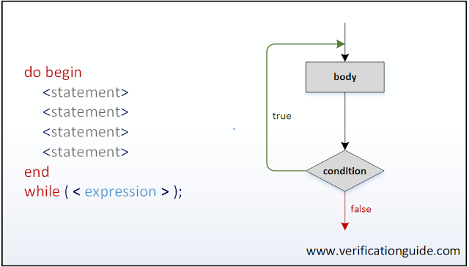
do ... while

Slide 62
Sample code
module do_while;
int a; // integer would require initial a=0;
initial begin :outer_loop
do
begin :inner_loop
$display(“\tValue of a=%d”,a);
a++;
end :inner_loop
while (a<5); // true: repeat loop/continue
end :outer_loop // false: break
endmodule

Slide 63
Results of do while
Value of a=0
Value of a=1
Value of a=2
Value of a=3
Value of a=4
// no Value of a=5 or higher

Slide 64
Top level module
instantiate testbench object, pass it a handle to BFM
  create new testbench
  bfm acts like a port list
  testbench_h = new(bfm);
  testbench has a copy of bfm, can use its tasks
launch verification
  testbench_h.execute();

Slide 65
testbench class
virtual tiny_bfm bfm;
  object equiv. of module's port list
tester, scoreboard, and coverage all get copies of bfm
virtual: interface handle isn't in bfm variable at compile time, but will be generated dynamically upon access

Slide 66
execute() method
instantiates tester, coverage, and scoreboard, each w/ a copy of bfm
fork: create three threads
just like initial fork or always fork in a module
execute() terminates, but threads continue (join_none)

Slide 67
tester class
works like a test generator module, but:
  class instead of module
  variable accesses BFM, rather than port list
  execute() method instead of initial block
  virtual tinyalu_bfm bfm;
    declares variable to hold bfm
    loads that value into the constructor

Slide 68
scoreboard class
scoreboard module: always @(posedge clk)
scoreboard class: execute () method w/ foreverloop, event waits for posedge clk

Slide 69
coverage class
covergroups, just like coverage module
call constructor to create covergroups

Slide 70


Slide 71
Ch 11 UVM tests
goal: compile testbench once
  change just arguments
  avoid recompiling for each new test scenario
dynamically configurable testbench
  instantiate new object for new test
Ch10: hardcoded test bench
Ch11ff: dynamic test bench

Slide 72
Create Tests w/ Factory
Ch 9: factory dynamically creates objects based on data available at runtime
  Ch 9: used a string to create objects
  class animal_ factory;
    static function animal make_animal(
    string species, int age, string name);
    case(species)
    "lion" : begin
    lion = new(age, name);

Slide 73
class animal_factory;
static function animal make_animal(
string species, int age, string name);
lion lion; // also chicken chicken; etc.
case (species)
"lion" : begin
lion = new(age, name);
return lion; // returns lion as animal variable
end
// other animal cases
endcase // case (species)
endfunction : make_animal
endclass : animal_factory

Slide 74
in the testbench
animal_h = animal_factory::make_animal(
"chicken", 3, "Boomer");
animal_h.make_sound();
animal_h = animal_factory::make_animal(
"lion", 15, "Mustafa"); animal_h.make_sound();
// could instead have loop that reads strings "chicken 3 Boomer" or "lion 15 Mustafa" from an external .txt file -- no recompile needed!

Slide 75
use factory for different tests
vsim testbench -coverage +UVM_TESNAME=add_test
vsim testbench -coverage +UVM_TESNAME=random_test
automate
  instantiate objects within testbench class
  launch each in its own thread

Slide 76
Ch 10 vs 11
10: SV module
  instantiated top-level class (testbench)
  launch test: testbench_h.execute();
11: automate
  store handle to BFM
  call run_test

Slide 77
Ch 11 module top industry-standard
import uvm_pkg::*; // UVM class defs, objs
`include "uvm_macros.svh"
tinyalu_bfm bfm();
tinyalu DUT (.A(bfm.A), ... .result(bfm.result));
initial begin
uvm_config_db
#(virtual tinyalu_bfm)::set(null, "*", "bfm", bfm);
run_test();
end

Slide 78
uvm_config_db class
UVM has parameterized static classes to store global information across testbench
works like animal cage queues:
  lion lion_h
  lion_h = new(15,"Mustafa");
  animal_cage #(lion)::cage_animal(lion_h);
separate queue (cage) for chickens
  (good for chickens, bad for lions?)

Slide 79
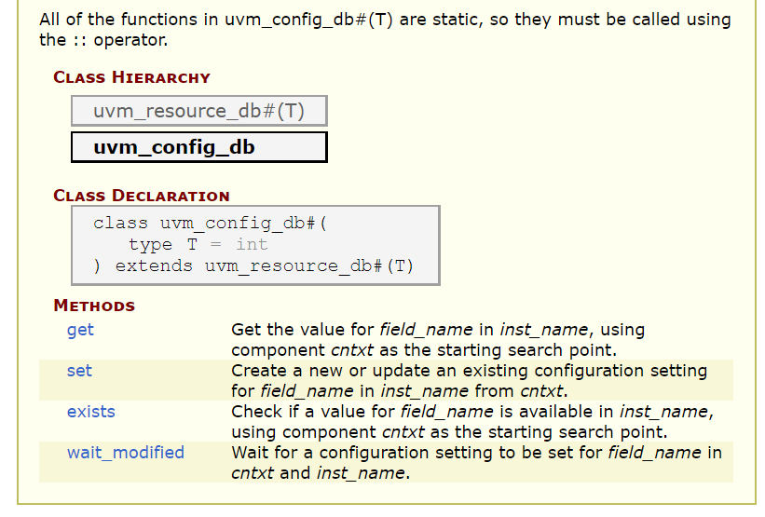
uvm_config_db

Slide 80
uvm_config set arguments
initial begin uvm_config_db #(
virtual tinyalu_bfm)::set(null, "*", "bfm",
bfm);
run_test();
end
// null, *: make data available across entire testbench
// "bfm", bfm: names data to be stored in database, value being stored (handle to tinyalu_bfm)

Slide 81
run_test();
inside uvm_pkg
reads +UVM_TESTNAME
  instantiates object of that class name
alternative 1
  pass run_test() a string containing test name (Chapter 9)
  requires recompilation for each new test

Slide 82
run_test();
alternative 2
  read test choice from an external file
  select argument for run_test() accordingly
  $readmemh("ch11_options.txt",mode_sel);
  if(mode_sel[0]==0) mode_choice = "add_test";
  else mode_choice = "random_test";
  string read would be more elegant, but this works

Slide 83
our two sample tests
Very typical:
  add_test
    single operation (add) returned
  random_test
    random operation (add, xor, and, mpy) returned
  randomized data either way
Often try constrained, limited tests first, then open up to random

Slide 84
Objection!
run_test() starts test (easy)
  spawns multiple threads
test runs as long as an object objects to ending it
in uvm_phase: an object can raise an objection to ending
raise objection before generating stimulus, drop objection when done

Slide 85
add_test.svh, random_test.svh
identical, except:
  name: random_test, add_test
  arugment: random_test, add_test
  object call: random_tester, add_tester
makes it easy to concoct new *_test classes

Slide 86
add_tester.sv, random_tester.sv
add_tester extends random_tester
operands are still chosen randomly
operation is set randomly in random_tester
operation selected in add_test
  overrides whatever operation choice is input
  bit[2:0] op_choice;
  return add_op; // add_tester
  op_choice = $random; // random_tester

Slide 87
Ch 12 UVM Components
example: uvm_test from Ch. 11
Usage:
  1) extend uvm_component class to define your component
  2) register w/ factory using `uvm_component_utils()
  3) provide uvm_ccomponent constructor
  4) override UVM phase methods

Slide 88
extending scoreboard
class scoreboard extends uvm_component;
`uvm_component_utils(scoreboard);
  registers class with factory
function build_phase;
task run_phase;

Slide 89
Ch 11 was:
class scoreboard;
task execute (); ...

Slide 90
uvm_component constructor
function new(
string name, uvm_component parent);
// bare minimum: call super.new
super.new(name,parent);
endfunction : new

Slide 91
default uvm phases
build_phase
  builds testbench hierarchy, top down
  instantiate uvm_components here
connect_phase
  stay tuned ... (obviously connects stuff together)
end_of_elaboration
  chance to adjust testbench after UVM hierarchy set up

Slide 92
default uvm phases
run_phase
  all run_phase methods launced simultaneously (unknown sequentially)
report_phase
  runs after last objection dropped
  test is finished

Slide 93
uvm phases per VerificationGuide
build
connect
end of elaboration
start of simulation
run
check
report

Slide 94
run_phase
The only task (time progresses) among functions (instantaneous)

Slide 95
build_phase
class random_test extends uvm_test;
function void build_phase(...);
tester_h = new("tester_h",this);
coverage_h = new("coverage_h",this);
scoreboard_h = new("scoreboard_h",this);
endfunction : build_phase

Slide 96
what the hell is "this"?
refers to class properties, parameters, methods of the current instance
use within non-static methods, constraints, covergroups
pre-defined object handle to invoke the method in which this is used
huh?

Slide 97
this example
class Packet;
bit[31:0] addr;
function new(bit[31:0] addr);
// addr = addr;
// uh, which addr should get assigned?
this.addr = addr;
// addr variable in Packet class gets assigned with local variable addr in new();

Slide 98
add_test
class add_test extends random_test;
`uvm_component_utils(add_test);
add_tester tester_h; // build phase
function new (string name, uvm_component parent);
super.new(name,parent);
endfunction :new
endclass

Slide 99
Ch 13 UVM Environments
moving from intractable code to adaptable
1) create classes which do one thing well
2) assemble classes to create solutions
3) minimize hardcoding behavior
4) program to interfaces
  no assumptions regarding implementation
have adaptable test -- compile once

Slide 100
add_test, random_test
both create testbench structure by instantiating components
modify testbench behavior by declaring different testers
want separate testbench structure and behavior

Slide 101
env.svh
does
  build phase
  connect phase
therefore, structure, not stimulus
defines testbench structure
instantiates objects in testbench
  coming: connect these together

Slide 102
factory
using static member/method technique for each uvm component
  automatic casting of factory output
  compiler catches undefined cases, misspellings
  catches missing `uvm_component_utils()

Slide 103
override -- for adapatability
function void build_phase(uvm_phase phase);
base_tester::type_id::set_type_override(
random_tester::get_type());
env_h =
env::type_id::create("env_h",this);
endfunction : build_phase

Slide 104
Ch 14 connect the dots
Two kinds of object connection:
  single-thread
    like UDP / broadcast
    User Datagram Protocol
    streaming applications; dropped packets OK
  dual-thread
    need to coordinate or synchronize between them
    like TCP/IP
    transmission control protocol
    request-acknowledge

Slide 105
Ch 15 Gambler's ruin
talking to multiple objects
  average (mean)
  histogram of frequency
  coverage report of bins
3 separate uvm_components

Slide 106
Average Class
protected reals:
  dice_total // cumulative
  count
dice_total = dice_total + t;

Slide 107
Launch in parallel
task run_phase
repeat(20) begin
the_roll = dice_roller_h.two_dice();
coverage_h.write(the_roll);
histogram_h.write(the_roll);
average_h.write(the_roll);
end

Slide 108
improving code
use top level to connect separate specialized classes together
observer design pattern
uvm analysis port

Slide 109
observer design pattern
creates data and shares it to any observer
each works on it as appropriate
dice_roller_h generates data
the other 3 objects are subscribers

Slide 110
observer design pattern
uvm_analysis_port -- lets object send data to subscribers
uvm_subscriber -- allows a component to subscribe to uvm_analysis_port

Slide 111
analysis port
declare variable to hold analysis port and define data type to travel through it
instantiate analysis port during build
write data into analysis port using write()
data in port goes to all subscribers
connect(): connects subscribers to port

Slide 112
subscriber
class provides analysis_export
class requires method write to handle data subscriber receives

Slide 113
making subscribers
class average extends uvm_subscriber #(int);
function void write(int t);
dice_total = dice_total + t;
count++;
endfunction

Slide 114
connect phase
comes after build phase
  which was done top-down
connect phase is bottom-up
  subscribers obtain analysis_export
    comes from uvm_subscriber
  analysis_port provides connect method
see dice_test.svh

Slide 115
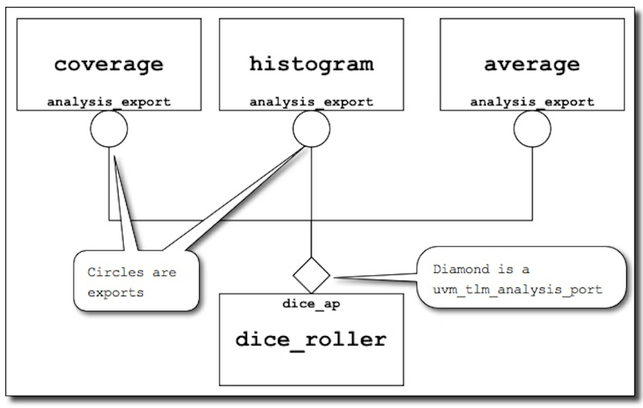
how analysis port works

Slide 116
analysis port in test bench
avoid duplicate code
coverage_h and scoreboard_h

Slide 117
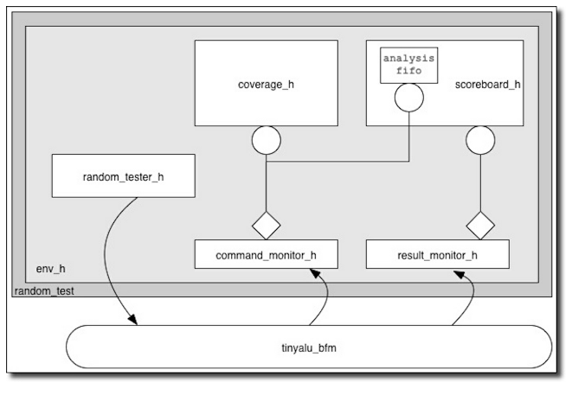
testbench w/ connections

Slide 118
bfm remains central
two analysis ports:
  get tinyALU command
  get tinyALU result
see new bfm code
  note monitor handles

Slide 119
command_monitor
use struct to bundle ops and opcode into DUT

Slide 120
scoreboard
subscribes to multiple (2) analysis ports

